Slide 1
STEP 7 – BRINGING IT ALL TOGETHER
Getting your app plugged in…

Slide 2
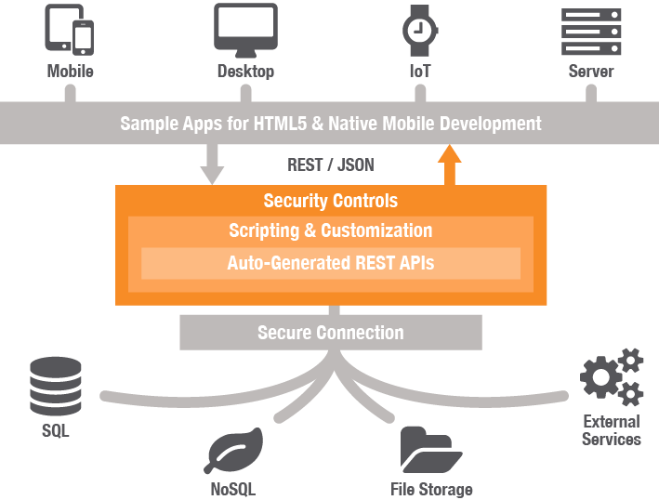
Step 7 Hooking Into Your Data
These are our dynamic data sources, but again here’s some things we need to be aware of:
How do we want to get our data?
Where do we want to store our data?
How easy would it be to intercept?
Will our app still load if this data were unavailable?
Our application will be a C# Web API 2.0 app serving JSON data

